Slide 1
Sensory Physiology III
Cortical representation
Dr Deepthi de Silva
Department of Physiology

Slide 2
At the end of this lecture you should be able to
State and identify accurately the locations of the primary (S1) and secondary (S2) somatosensory cortex and the sensory association area
Outline the spatial orientation of the S1 and S2 and the roles of S1, S2 and the sensory association areas
Outline the touch and proprioceptive pathways
Outline the physiology of temperature change detection and the pathway for temperature
Outline the pathway for itch and tickle sensations
Outline the mechanism for detecting vibration
State the definitions of stereognosis and two point discrimination and outline the role of the cortex in their detection

Slide 3
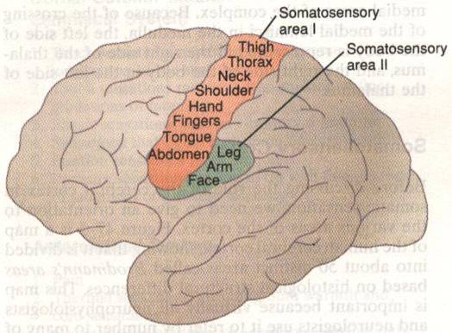
Cortical representation
Somatic sensory input to somatosensory cortex
Somatosensory area 1
(S I)
  Parietal lobe, behind central sulcus
Somatosensory area 2
(S II)
  Wall of sylvian fissure
Sensory association area
  Behind SI
Somatosensory
area 1
Somatosensory
area 2

Slide 4
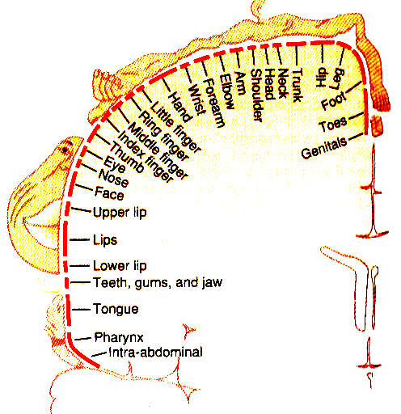
Somatosensory area 1 (S I)
Parts of body represented
Information from contralateral (opposite) side of body
Large representation for lips and thumbs
  Less area for trunk
Plasticity : neuronal connections change

Slide 5
Somatosensory areas
S1 stimulation- sensations projected to specific body parts
Histologically organised in vertical columns- with specific sensory modality in each column
SII
? Less important but function not clear
Less complete/ detailed representation of body
Input from sensory area 1, other cortical and brain stem areas

Slide 6
Somatosensory Association Area
Lies behind somatosensory area 1
Close to visual and auditory cortex
Identifies deeper meaning/s of sensations

Slide 7
Touch and its associated sensations

Slide 8
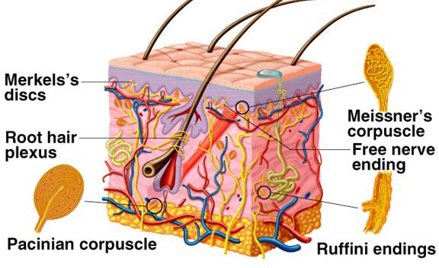
Touch- stimulation of touch receptors in or near skin
Pressure – sustained touch that stimulates deeper tissue receptors
[Vibration]-alternating touch and pressure

Slide 9
Pathways for touch sensation
Touch sensation in dorsal column
  Detailed localisation of position
  Shape recognition
  Duration of touch
Touch sensation in anterolateral pathway
  Poorly localised (crude) touch sensation

Slide 10
Proprioception
(Position sense)
Slowly adapting receptors
Sensory afferents from receptors in
  skin, muscles, joints, tendons
  pressure from feet
  [Inner ear vestibular system also involved]
Transmitted mainly via dorsal column
Processed in cerebellum, cortex and other areas
Loss of proprioception causes ataxia
(read up Romberg sign)

Slide 11
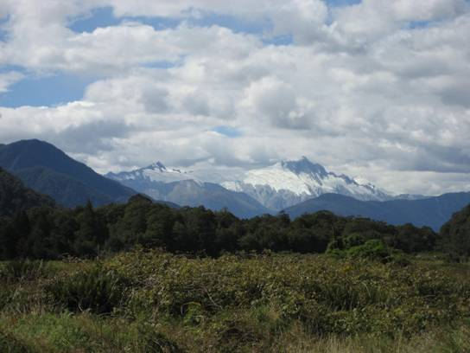
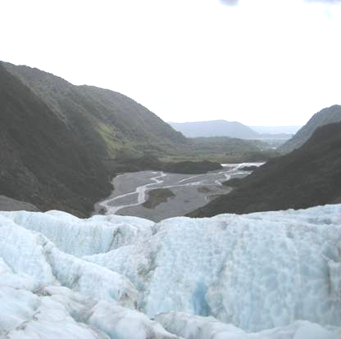
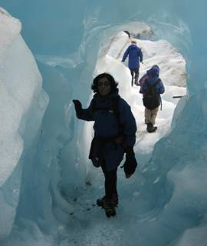
Temperature
Fox Glacier
New Zealand

Slide 12
Temperature Receptors
Specific ‘cold’ and ‘hot’ receptors in different skin areas (cold > warm)
  Adapt to constant temperatures
Cold receptors range from 10- 24^{₀} C
  < 10^{₀}C, no firing; cold becomes an anaesthetic
  TRPM8 Receptors (menthol stimulates this: mint taste in sweets is cooling)
Warm 30-46^{₀} C
  TRPV4 at moderate temp; TRPV3 at higher temp
At extremes of temperature, pain receptors stimulated
Anterolateral pathway

Slide 13
Temperature
Receptors in skin
  Receptors respond to temp changes and adapt to maintained temperature levels
Cold receptors
  respond to temperatures of 10° -38° C
  Afferents Aδ and C fibres
Warm receptors
  respond to temperatures between 30° - 45°C
  Afferents C fibres
At extremes of temperature, pain receptors stimulated
Anterolateral pathway

Slide 14
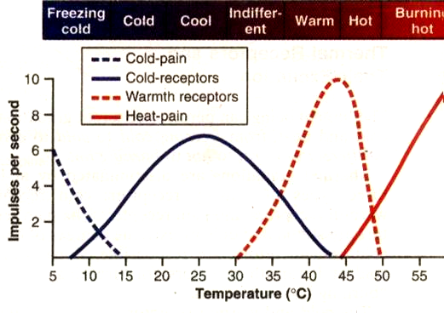

Slide 15
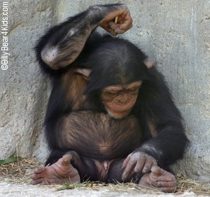
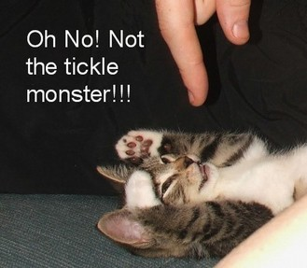
Itch and tickle

Slide 16
Itch and tickle
Itch can be uncomfortable; relieved by scratching
Tickle ? Enjoyed
Stimulus – slight movement over skin
Receptors- naked nerve endings
Afferents – C fibres
Pathway- anterolateral

Slide 17
‘Synthetic’ senses
Combination of stimulating different sensory receptors & pathways
  Vibration
Cortical involvement for sense detection
  Two point discrimination
  Stereognosis

Slide 18
Vibration
Rapidly changing touch/ pressure called vibration
  - Tested using tuning fork
Aβ afferents via dorsal column pathway
Clinically important- loss of vibration in dorsal column lesions e.g. diabetes mellitus, vitamin B12 deficiency, tabes dorsalis

Slide 19
Two point discrimination
Minimum distance at which two touch stimuli have to be separated to be detected as separate
Touch receptors and Cortical component to identify stimuli as separate
Helped by lateral inhibition
High discrimination in hands; low in back

Slide 20
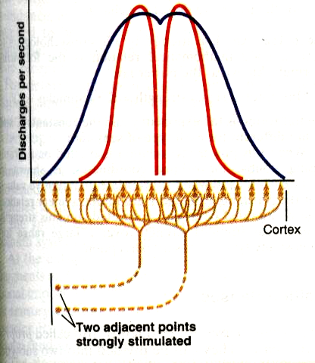

Slide 21
stimulus
No lateral inhibition
stimulus
Lateral inhibition present
stimulus
Interneuron for lateral inhibition
stimulus

Slide 22
Stereognosis
Ability to identify an object without looking at it
Touch/ pressure receptors and dorsal column pathway
Cortex essential
Ability lost in damage to cerebral cortex

Slide 23
True or false?
Vibration is a synthetic sense
Loss of vibration sense is a feature of damage to the spinothalamic pathway
Two point discrimination is better in areas with more touch receptors
Stereognosis indicates loss of the ability to identify objects without looking at them
Loss of proprioceptive information causes unsteadiness

Slide 24
Damage to spinal Cord: Sensory loss
Dorsal column lesion
Anterolateral lesion

Slide 25
Damage to dorsal column
Loss of position sense, vibration, two point discrimination
Rise in touch threshold/ poor localisation of touch
No loss of pain/ temperature
Sensory Ataxia
Anterolateral pathway damage
Loss of pain and temperature sense
No loss of position sense, vibration, two point discrimination
Normal touch threshold/ Normal localisation of touch
No ataxia

Slide 26
Making sense of sensation
Modality –
  what type of sensation is this?
Intensity-
  how weak or strong is this sensation?
Location –
  where is this sensation coming from?
Duration
  How long does the sensation last?
Can you explain how the sensory system can determine the above?

Slide 27
Can you
State and identify accurately the locations of the primary (S1) and secondary (S2) somatosensory cortex and the sensory association area
Outline the spatial orientation of the S1 and S2 and the roles of S1, S2 and the sensory association areas
Outline the touch and proprioceptive pathways
Outline the physiology of temperature change detection and the pathway for temperature
Outline the pathway for itch and tickle sensations
Outline the mechanism for detecting vibration
State the definitions of stereognosis and two point discrimination and outline the role of the cortex in their detection

